Slide 1
Gradle Build Tool
Pavel Vrublevskij

Slide 2
Introduction
Ant -> Maven -> Gradle

Slide 3
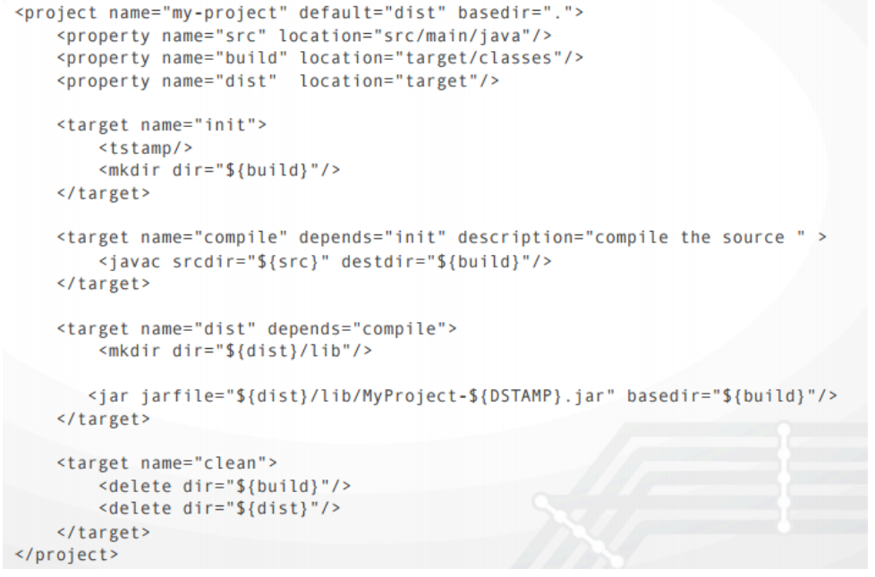
Typical Ant build.xml

Slide 4
Same in Maven
<?xml version="1.0" encoding="UTF-8"?> <project xmlns="http://maven.apache.org/POM/4.0.0" xmlns:xsi="http://www.w3.org/2001/XMLSchema-instance" xsi:schemaLocation="http://maven.apache.org/POM/4.0.0
http://maven.apache.org/xsd/maven-4.0.0.xsd"> <modelVersion>4.0.0</modelVersion> <groupId>lt.asprogramuoju.sample</groupId> <artifactId>my-project</artifactId> <version>1.0-SNAPSHOT</version> </project>

Slide 5
Same in Gradle
build.gradle settings.gradle
plugins { id 'java' } group = 'lt.asprogramuoju.sample' version = '1.0-SNAPSHOT’
rootProject.name = 'my-project'

Slide 6
Gradle vs Maven more about difference https://gradle.org/maven-vs-gradle/

Slide 7

Introduction
Gradle is an open-source build automation tool focused on flexibility and performance. Gradle build scripts are written using a Groovy or Kotlin DSL.
Why?
Highly customizable — Gradle is modeled in a way that is customizable and extensible in the most fundamental ways.
Fast — Gradle completes tasks quickly by reusing outputs from previous executions, processing only inputs that changed, and executing tasks in parallel.
Powerful — Gradle is the official build tool for Android, and comes with support for many popular languages and technologies.

Slide 8
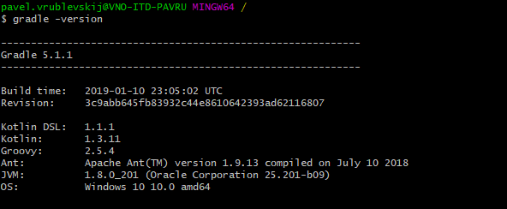
Download first
https://gradle.org
Go thru Installation guide, make for yourself
Check if all work fine:

Slide 9
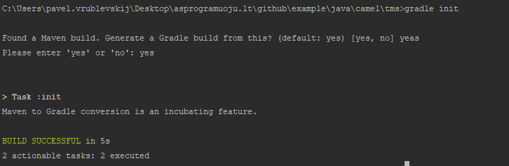
Init gradle in your existing project
gradle init

Slide 10
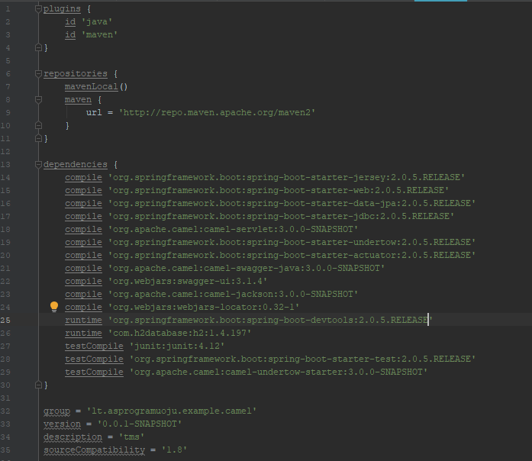
Example

Slide 11
Maven dependency to gradle
<dependencies> <dependency> <groupId>org.springframework.boot</groupId> <artifactId>spring-boot-starter-jersey</artifactId> </dependency>
...
...
Same
dependencies { compile 'org.springframework.boot:spring-boot-starter-jersey:2.0.5.RELEASE’

Slide 12
Learn more at
https://gradle.org
Don’t forget groovy language: http://groovy-lang.org/

